Slide 1
Online Examportal
Soundarya VL
AXISB1013

Slide 2
Overview Of the Project
Online Examination System is a technology-driven way to simplify examination activities like defining exam patterns with question banks, defining exam timer, objective/ subjective question sections, conducting exams using the computer or mobile devices in a paperless manner.

Slide 3






TECHNOLOGIES USED

Slide 4
Features
CRUD operations on categories
CRUD operations on quiz
CRUD operations on questions

Slide 5
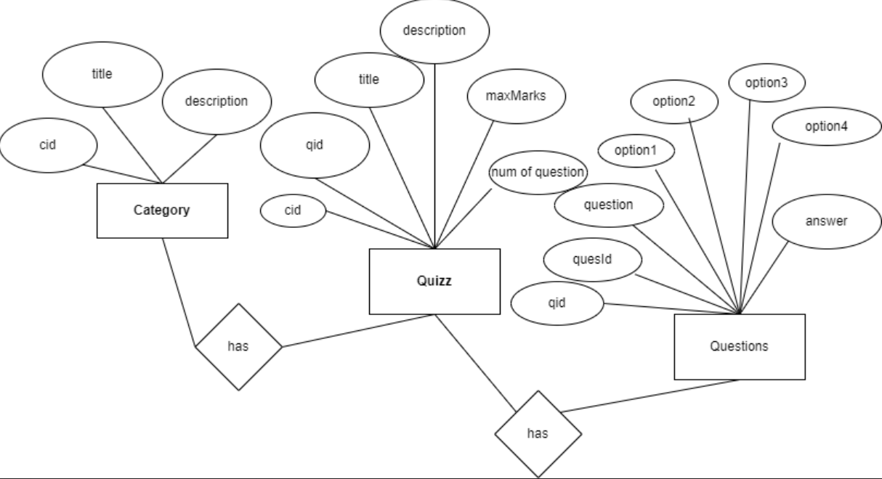
Use case diagram

Slide 6
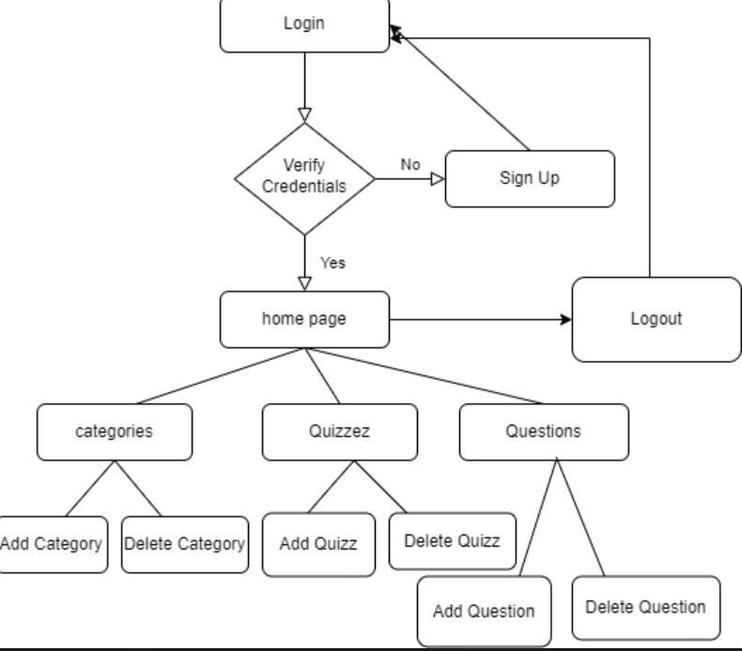
Flow chart

Slide 7
Future Implemetation
Adding timer for the quizzes
Report Card in pdf form
Verifying the credentials through gmail

Slide 8
FIN

